Slide 1
CSCI 152
Calvin Tey,Majid Farhadloo,Jason Pieros,Yesol Lee,Shaoyu Pei

Slide 2
Different people do different data science
Computer science:
Playing with data Geometriclly
Statistician:
Probabilistical explanation

Slide 3
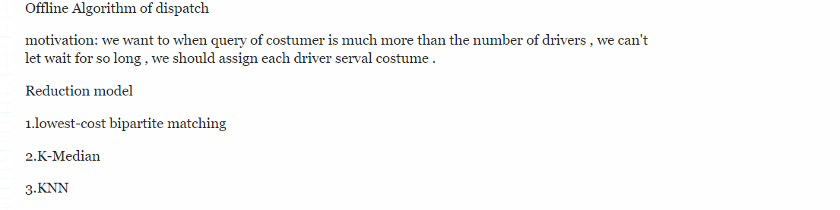

Slide 4
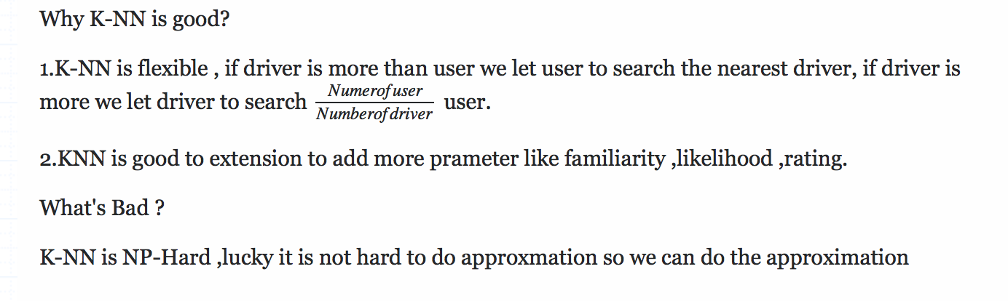
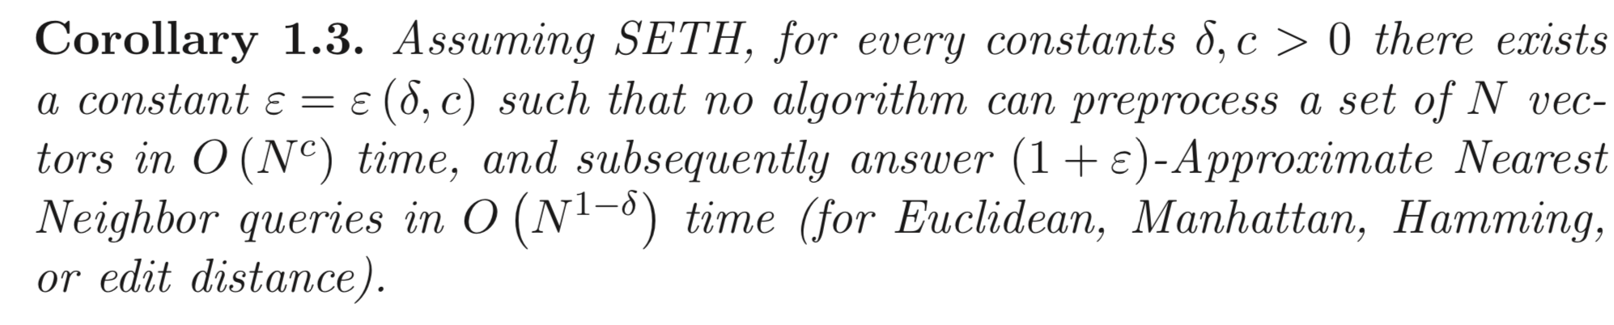

Slide 5
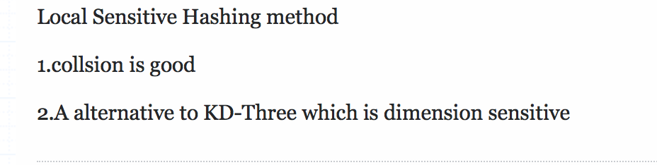

Slide 6
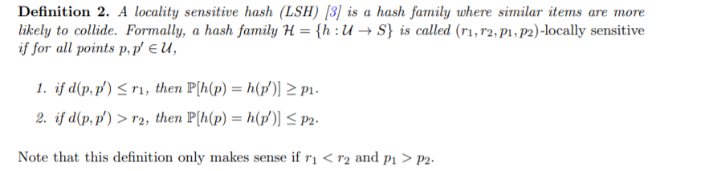
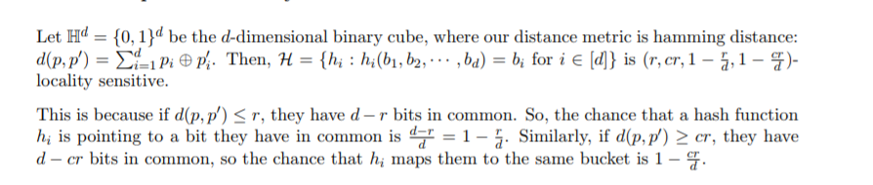

Slide 7
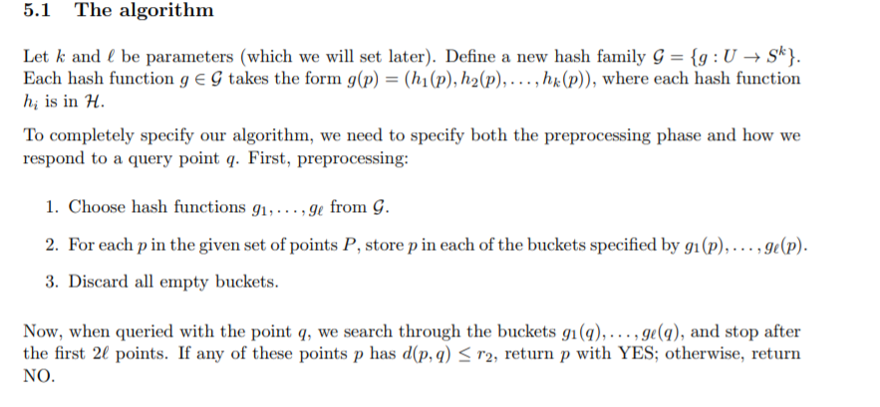

Slide 8
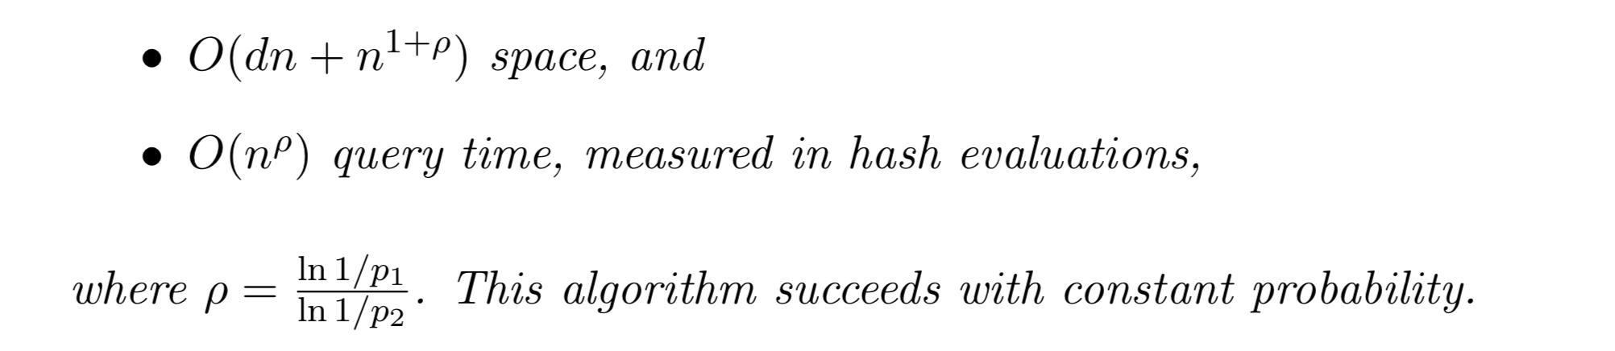
Theoretical Guarantee

Slide 9
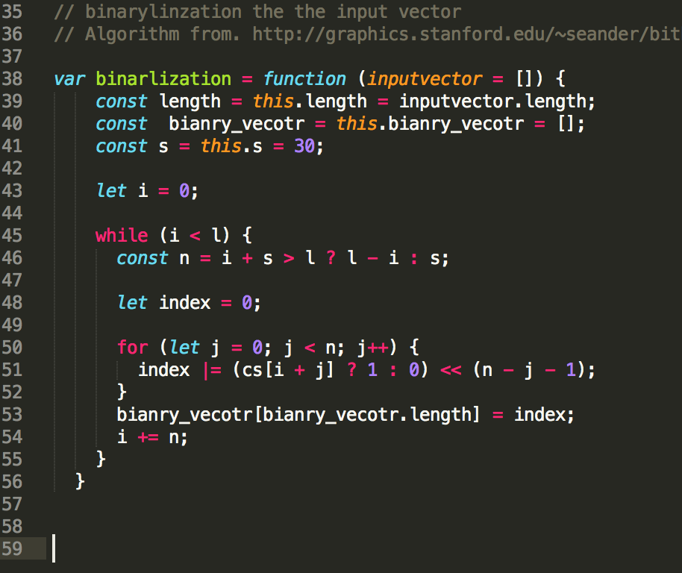
Implmentation of key step

Slide 10
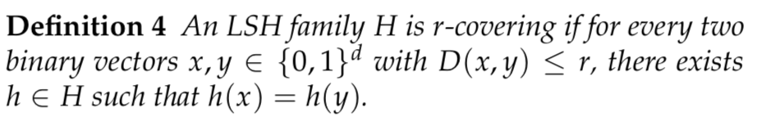
Implement of key step

Slide 11
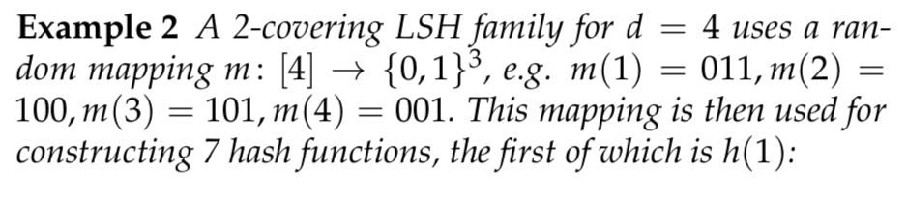
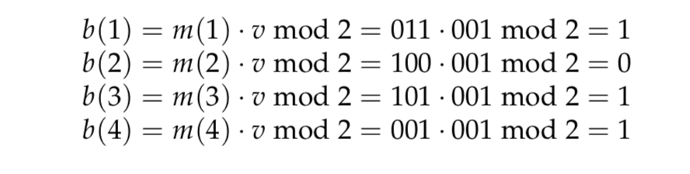

Slide 12
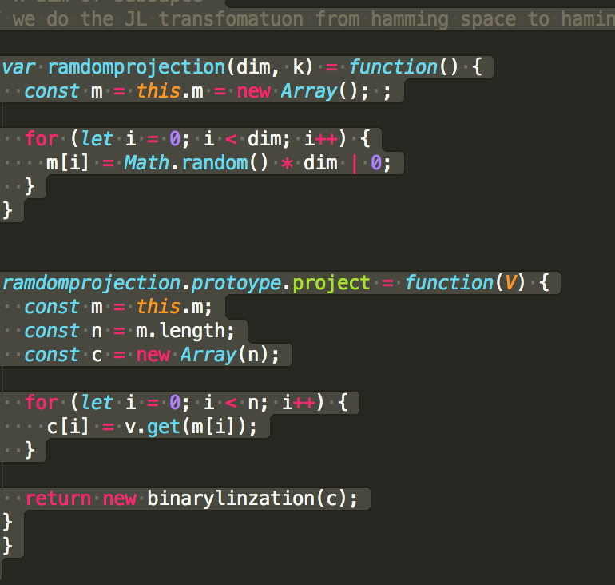
Implementation of key step(ramdom prohection)

Slide 13
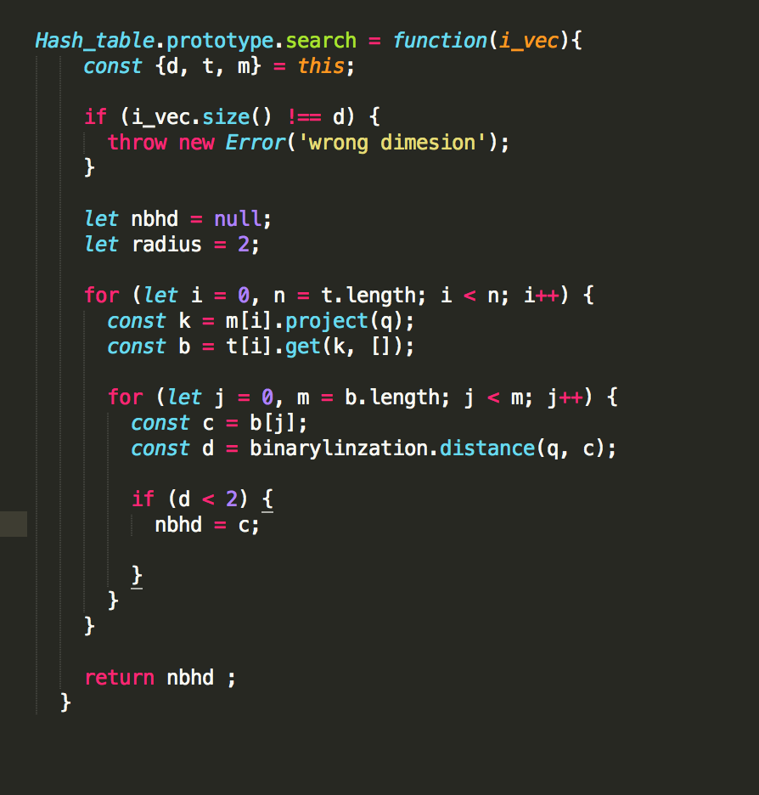
Implementation of key step(search)

Slide 14
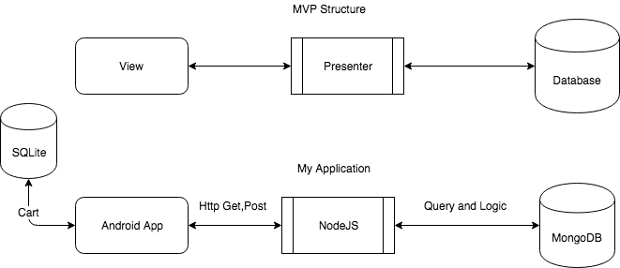
Software Architecture
Update
Read/Write
Model

Slide 15
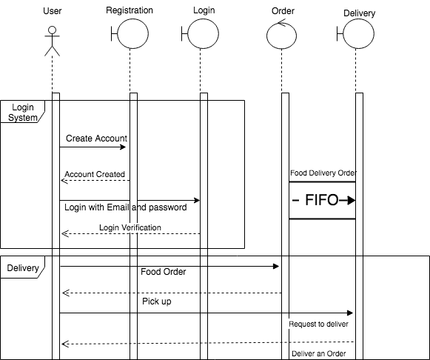
Sequence Diagram

Slide 16
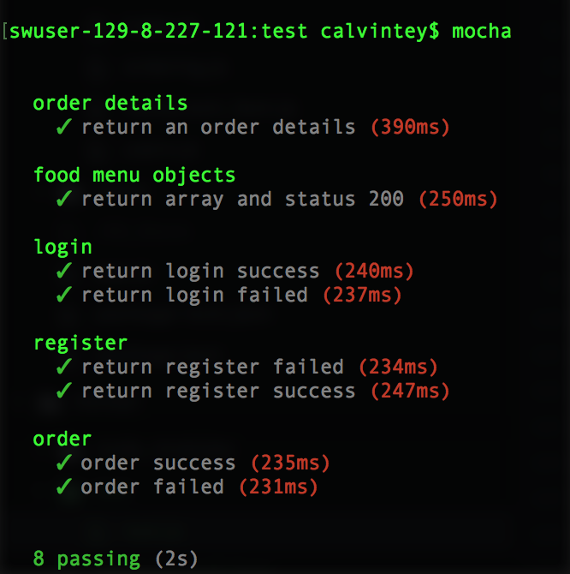
Test case for NodeJS
Mocha and Chai
JavaScript Testing library
Request and Should
Library for testing Get/Post request
Return value validation
API testing
Tested with Url
Example

Slide 17
Node.js testing
CODES...
Order details
Food menu objects
Login - success or fail
Register - success or fail
Order - success or fail

Slide 18
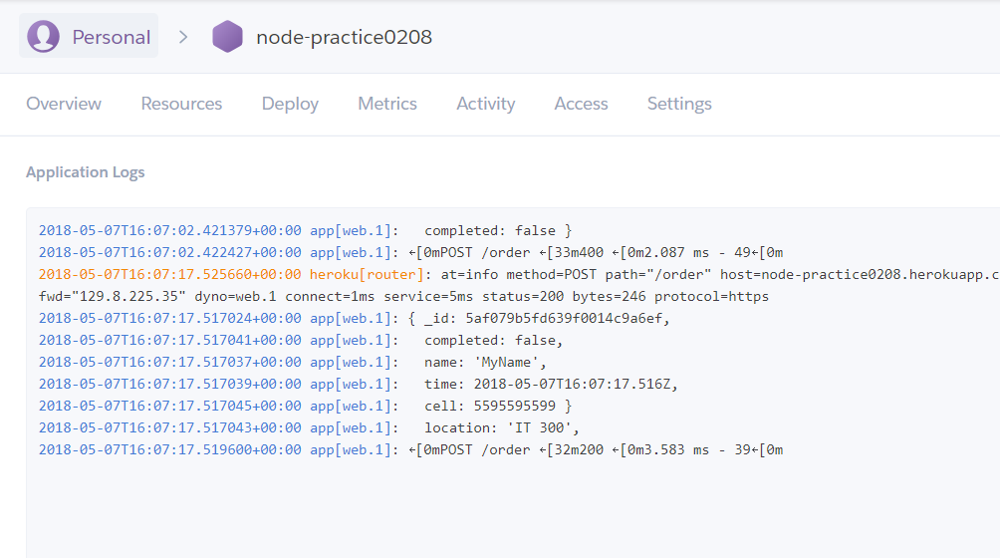
Node.js server
Heroku
Deploy Node.js app
Debugging and logs

Slide 19
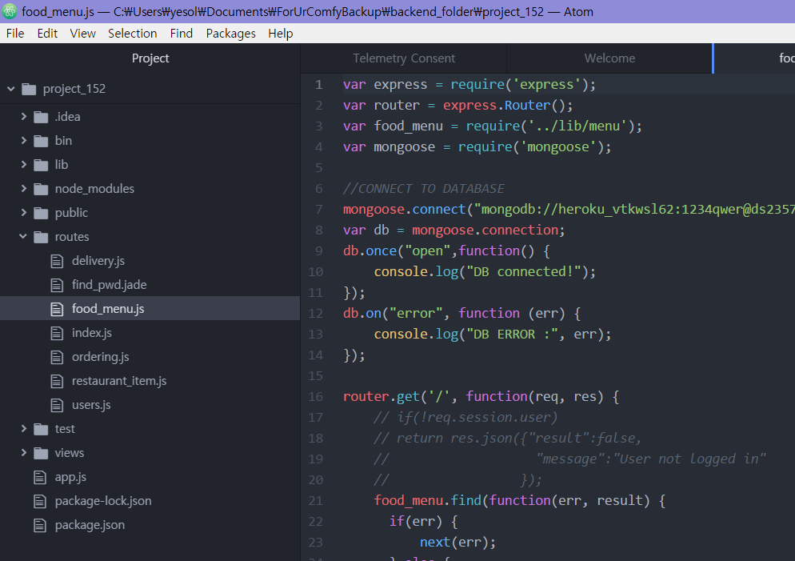
Tool For Node.js
Atom Editor
Open source
Built-in package manager
User custom themes
Github integration

Slide 20
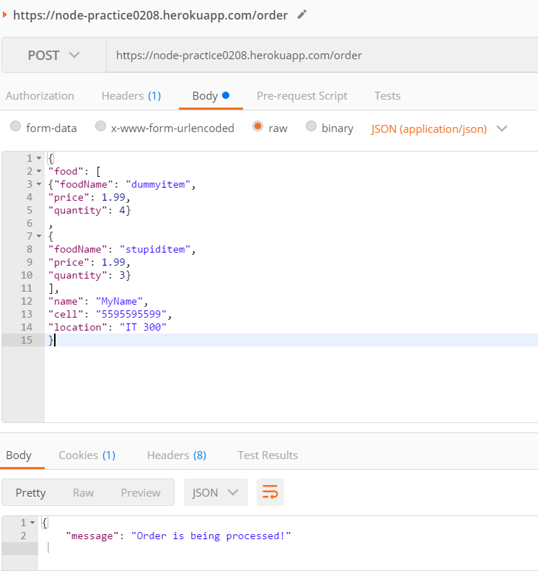
Tools for Debugging and Testing APIs
Postman
Send API request and get response
Debugging and logs
Documentation!!

Slide 21
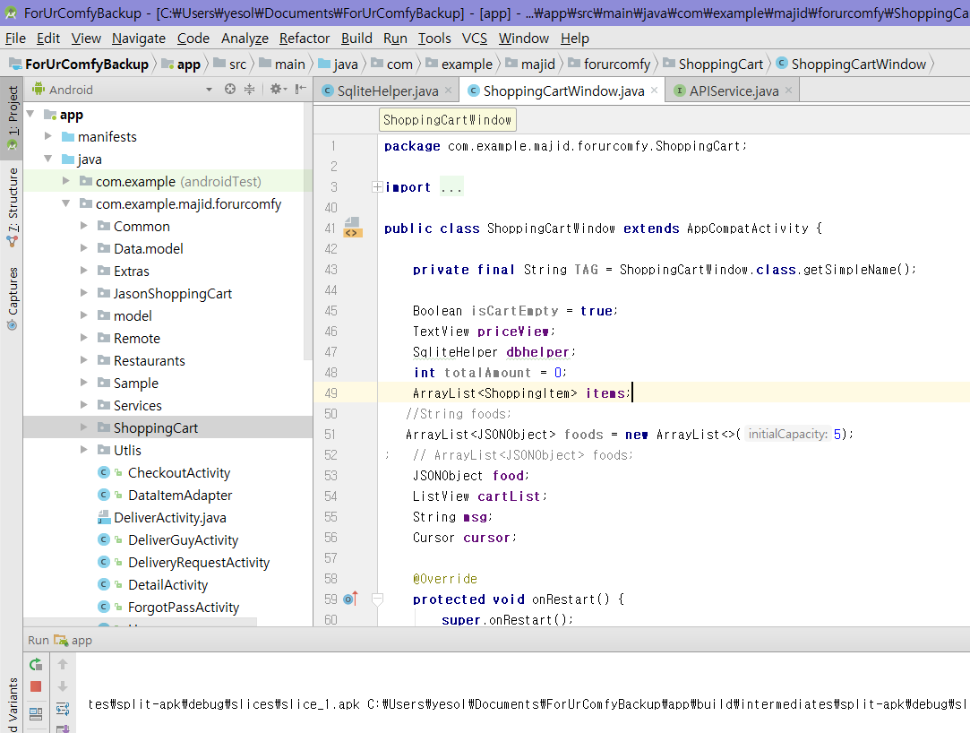
Android Studio
Android Studio
Intellij based

Slide 22
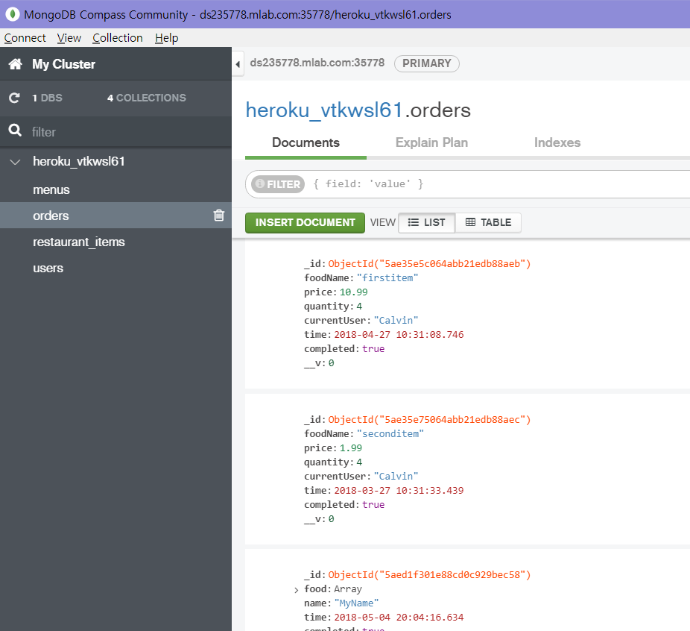
Tool for mongodb management
Mongodb Compass Community
View db data

Slide 23
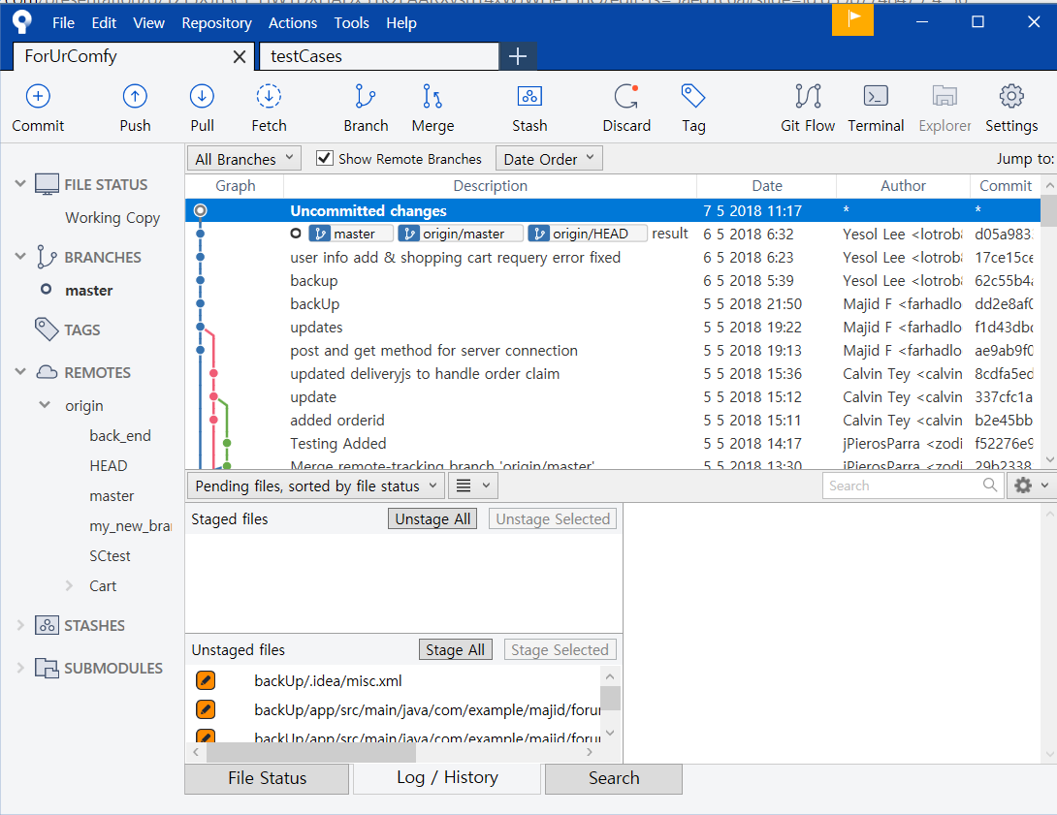
Tool for efficient use of git
Source Tree
GUI

Slide 24
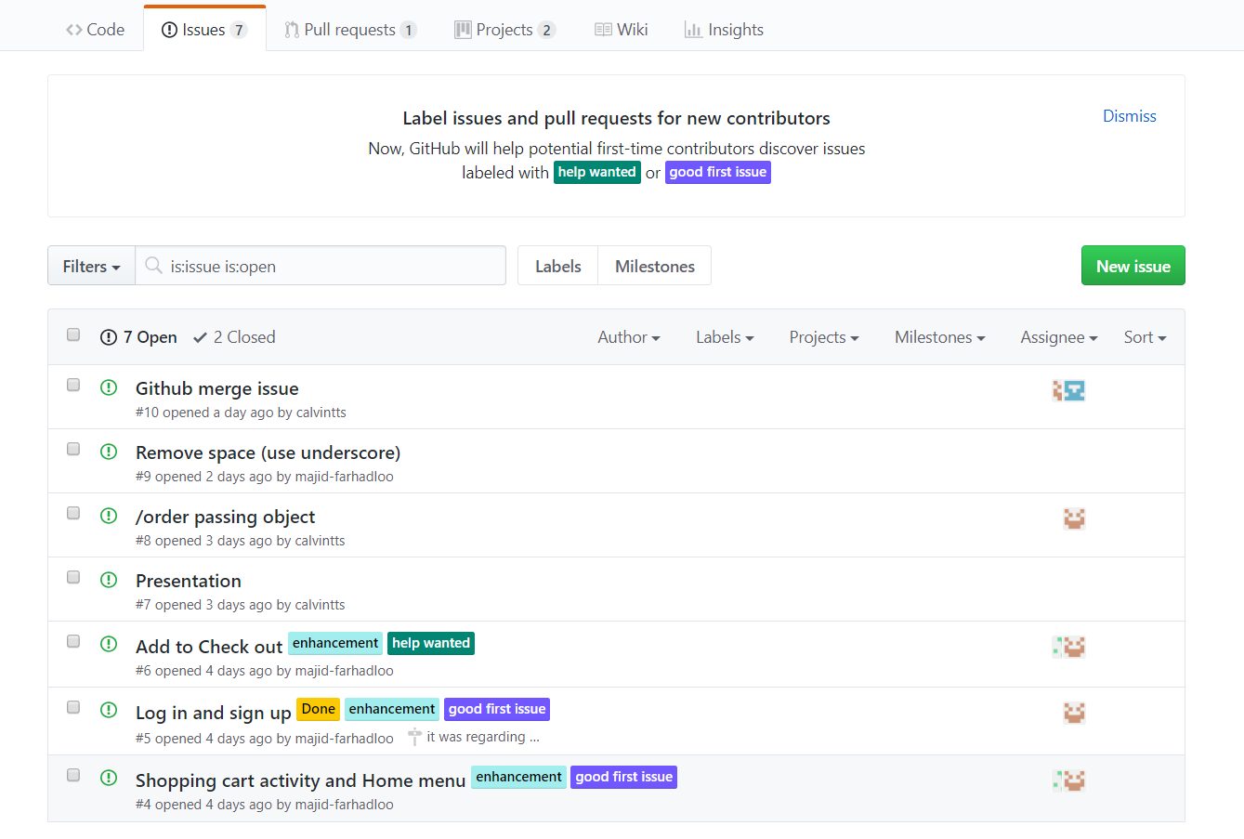
GITHUB

Slide 25
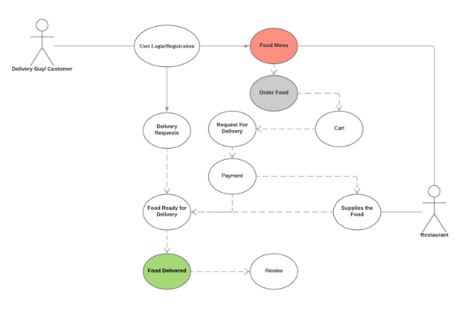
Use Case Diagram

Slide 26
Implementation
Everything initially starts from android as user interface.
Android is our viewer in our MVP. (Model View presenter)
Simply then we either are a new user who are register, or we already have account and then we just login.
The on Home page you have option from menu navBar to be deliverer or customer
If customer then go restaurant menu.

Slide 27
Implementation
Let See some Code …..
Go to android studio….

Slide 28
Black Box Testing USING Robotium
White Box Testing UsING ESPRESSO
-Register
-Login
-Access to Restaurant Menu
-Add food item to Cart
-Checkout / Payment Info

Slide 29
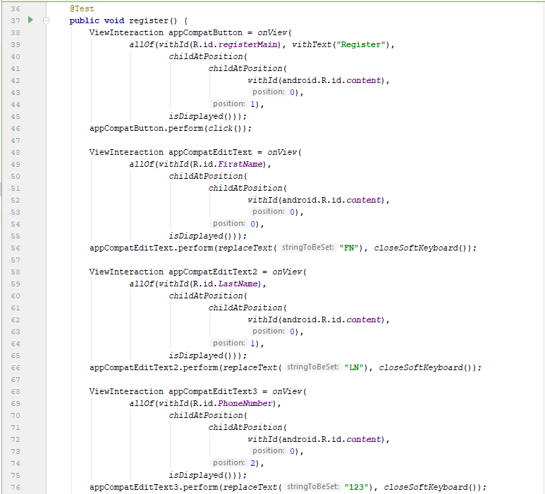
Register
Test Case
Example

Slide 30
Q&A

